Slide 1

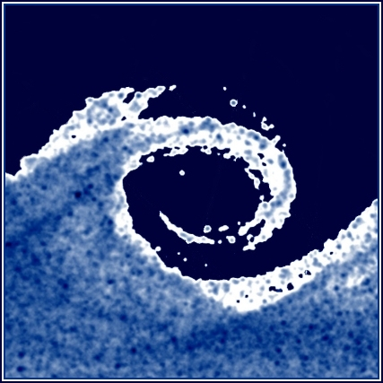
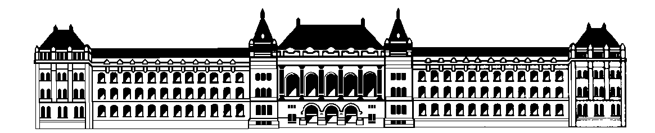
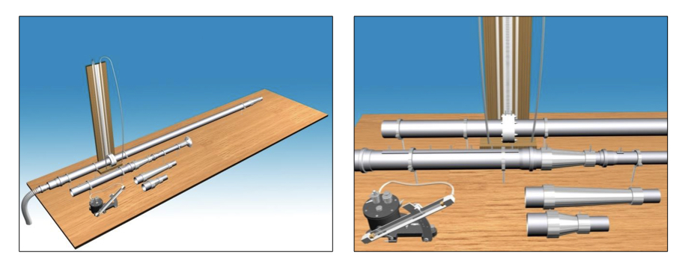
Fluid Mechanics Project Presentations
DEPARTMENT OF FLUID MECHANICS
Budapest University of Technology and Economics
DETERMINATION OF THE CHARACTERISTICS OF A DIFFUSER
Muhammad Kevin Fahlevi (Leader) Özcakir Öykü (Helper) Murimi Brendan Wanjohi (Helper) Measurement Date: November 7th, 2023 | QFR5R2 YM7V9F KJBF64
Measurement Group Members:
Instructor :
Dr. Bendegúz Bak
2023. 12. 05.
Fluid Mechanics project presentation

Slide 2
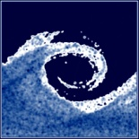
Short Description of the Measurement
Goal of the measurement:
The laboratory testing requires determining the diffuser efficiency (ηdiff).
Efficiency analysis involves plotting results in diagrams, examining efficiency concerning diffuser angle (α) and volume flow rate (qv).
The measuring setup includes a Borda-Carnot element and two diffusers (6° and 30° angles), excluding the 15° diffuser. Adjustment options include the volume flow rate and the length of the flow straightener segment after built-in components.
Description of the measurement task:
Measure the pressure differences at the inlet orifice plate (IOP) towards the surrounding and two sections of the standardized orifice plate (SOP) in three levels of volume flow rates.
Measure the pressure difference at the IOP and the diffuser, as well as the pressure drop at all seven pressure taps on the measurement section. Calculate the downstream distance between the reference point and all seven pressure taps.
Calibrate the digital manometer with the assist of the Betz Manometer and a syringe.
Fluid Mechanics project presentation
<number>.

Slide 3
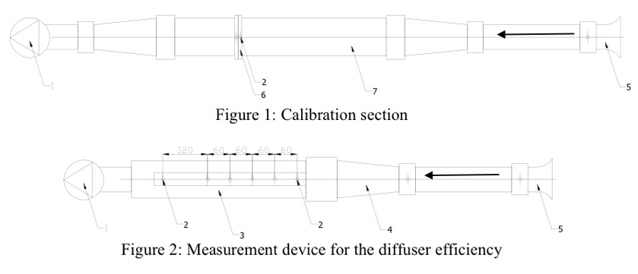
Description of the Measurement Set-Up
1st set – up: Calibration of the Inlet Orifice
2st set – up: Diffuser Efficiency Testing
Fluid Mechanics project presentation
<number>.

Slide 4
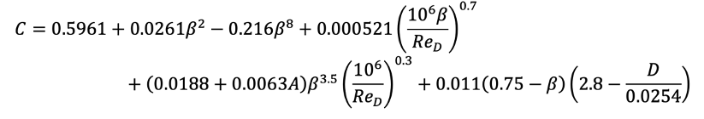
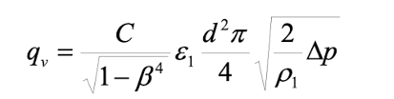
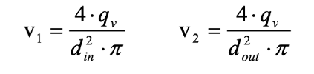
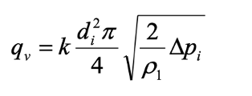
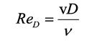
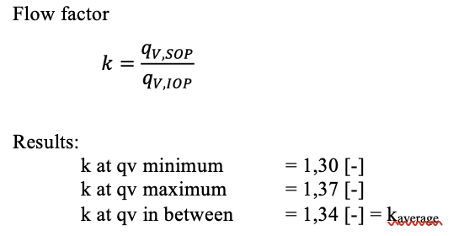
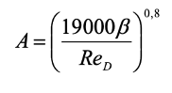
The Applied Formulas
Calibration of the Inlet Orifice:
1. Flow Coefficient
2. Volume Flow Rate – Standardized Orifice Plate (SOP)
3. Pressure Drop and Velocity
6. Volume Flow Rate – Inlet Orifice Plate (IOP)
4. Reynold Number (Re_{D})
7. Flow Factor
5. Factor A
8. Results
Fluid Mechanics project presentation
<number>.

Slide 5
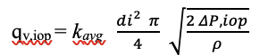
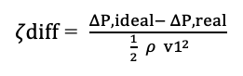
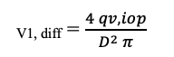
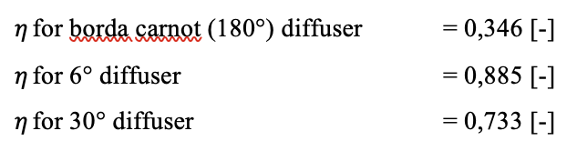
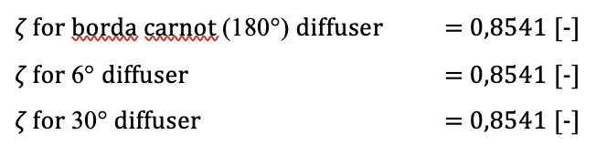
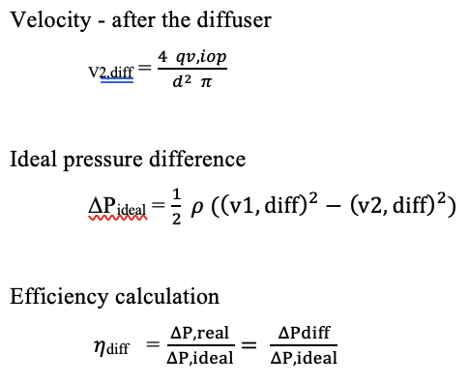
The Applied Formulas
Diffuser Efficiency Testing:
1. Volume Flow Rate – Inlet Orifice Plate
6. Loss Factor
2. Velocity – In Front of the Diffuser
7. Results
3. Velocity – After the Diffuser
4. Ideal Pressure Difference
5. Efficiency
Fluid Mechanics project presentation
<number>.

Slide 6
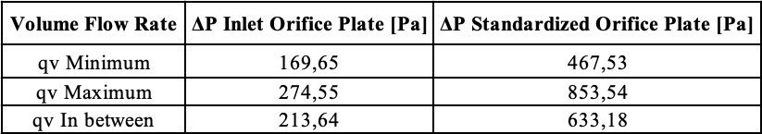
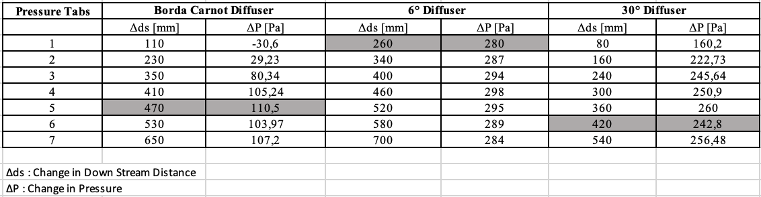
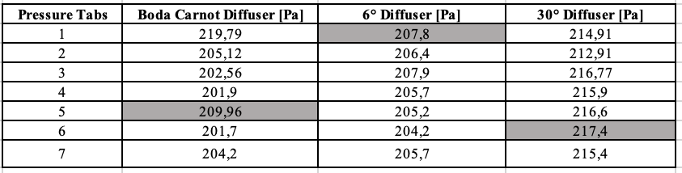
The Investigated Physical Parameter
Calibration of the Inlet Orifice:
Diffuser Efficiency Testing:
Pressure changes between the pressure tabs and diffusers
Pressure changes between the pressure tabs and the inlet orifice plate from three diffusers
Fluid Mechanics project presentation
<number>.

Slide 7
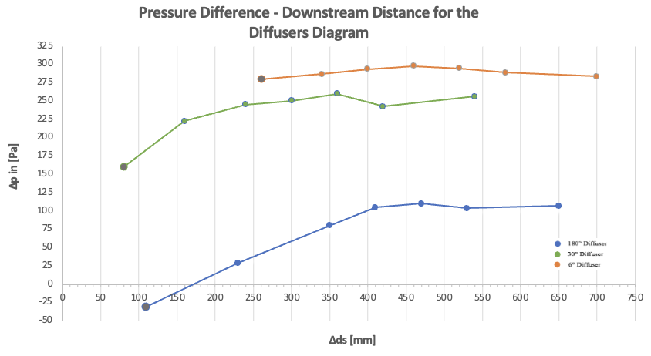
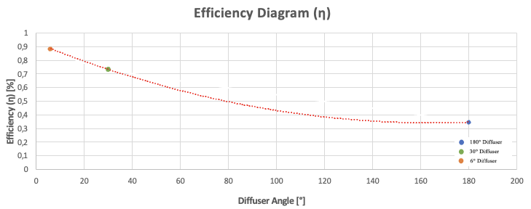
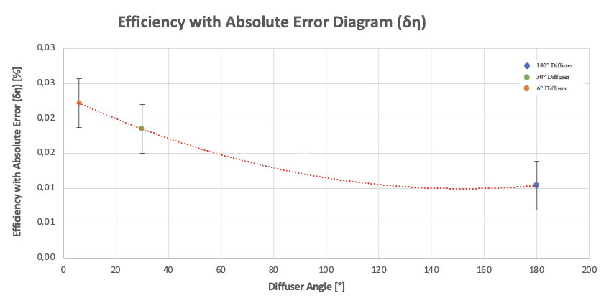
The Investigated Analytical Graph
Fluid Mechanics project presentation
<number>.

Slide 8
Summary and Conclussion
This fluid mechanics laboratory investigated the efficiency of three different diffusers in a methodical manner. Diffusors with smaller opening angle (6° and 30° diffuser) are often more efficient than those with greater angles (borda carnot diffuser), according to the numerical data and graph. In addition, the pressure diagram illustrates the relationship between the opening angle and the flow separation distance. It is evident that a quick increase in opening angle (diameter) could influenced a greater separation.
THANK YOU
Fluid Mechanics Project presentation
<number>.

